Slide 1

Is Fragmentation a sin?
Discussion through some case studies
Research Workshop on Fragmentation in Air Traffic and ist impact on ATM Performance
14-15.05.2019 Budapest/Hungary
Robert Anton, Niels Lokman, Edouard Pitton, Matthias Whittome
V0.3

Slide 2
What is Fragmentation?
Fragmentation = "torn apart or crashed into pieces"
Usage in other industries:
Medicine: elimination of substances (e.g. fragmentation of kidney stones)
Computer: storage or processor architecture
Energy supply market:
decentral (e.g. coal) ➔ central (e.g. nuclear power) ➔ decentral (e.g. solar panels)
Fragmentation is not necessarily linked with efficiency.
Optimal Level of fragmentation depends on available technology and evolves over time

Slide 3
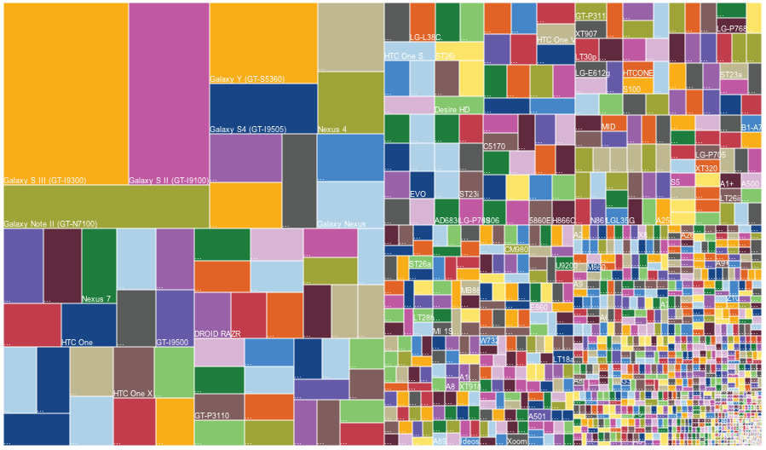
Fragmentation of Android Devices

Slide 4
Fragmentation in European ATM
How to measure Fragmentation? Consider possible indicators…
Indicator | Minimum | Maximum | Average | Factor | Median
IFR ACC Movements | 109.184 | 5.056.957 | 1.156.598 | 46,3 | 662.629
Size of controlled Airspace | 20.400 | 2.190.000 | 368.660 | 107,4 | 202.000
ATCOs in OPS | 51 | 2.859 | 504 | 56,1 | 236
Total staff | 146 | 7.669 | 1.410 | 52,5 | 808
Total IFR flights controlled by the ANSP | 110.385 | 3.051.154 | 903.136 | 27,6 | 636.982
Total IFR km controlled by the ANSP | 38.076.948 | 1'647.941.888 | 317.738.640 | 43,3 | 200.200.879
Total flight-hours controlled by the ANSP | 50.608 | 2.287.512 | 453.326 | 45,2 | 268.136
Number of ACC operational units | 1 | 5 | 2 | 5,0 | 1
Gate-to-gate ATM/CNS provision cost (in €'000) | 17.926 | 1.253.962 | 246.874 | 70,0 | 133.489
Key Data of European ANSPs; Source: Eurocontrol/PRU Dashboard, Data from 2016

Slide 5
Normed Gini Coefficient for controlled flight hours 2004 – 2016
Figure: Evolution of the normed Gini coefficient (G*) for controlled flight hours from 2004 to 2016
The level of fragmentation has decreased in the past 12 years
The smaller ANSPs have experienced higher growth rates in flight hours controlled than larger ones
A merger of the smallest four ANSPs in 2004 would have led to a similar Gini value in 2016,
only achieved by traffic growth

Slide 6
Lorenz Curve for controlled flight hours 2016 as share in % per ANSP
Judgment on Fragmentation in European ATM:
Which indicator to use to measure?
What does the indicator tell?
What is the impact of fragmentation on performance?
Input by some case studies
Figure: Lorenz Curve for controlled flight hours in European ATM in 2016 as a share in % per ANSP
Lorenz Curve shows the distribution of the output of controlled flight hours

Slide 7
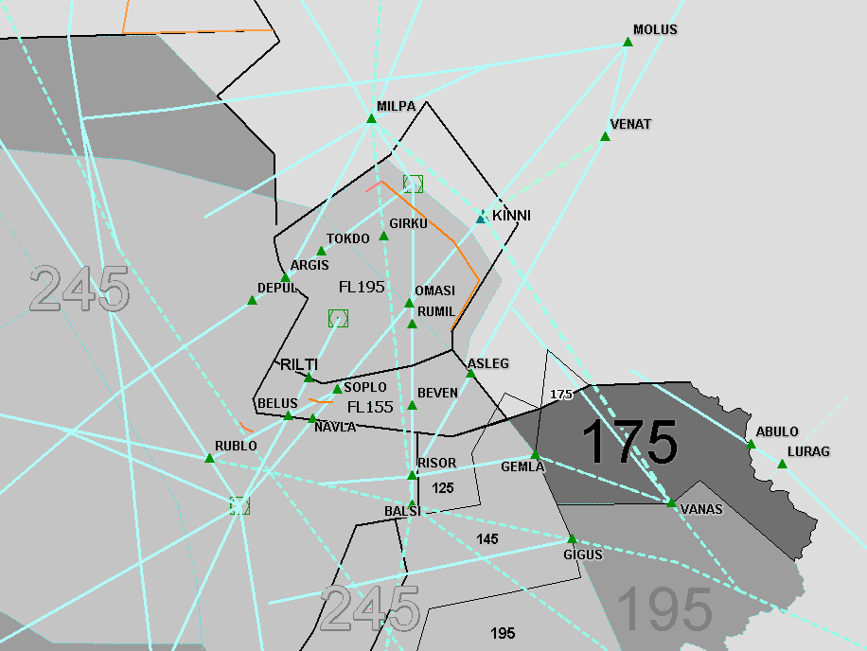
Case Study DSNA I : the BALSI-Project
Switching sectors (upper/lower levels) between Marseille and Geneva ACCs, depending on QFU in service in GVA
(--- border FR/CH)
The BALSI-Project has led to more fragmentation at interface franco-Suisse, Genève-Lyon airports.
Innovative approach: dynamic airspace configuration, between 2 ACCs, cross-borders:
the Area of Responsibility switches between DSNA and Skyguide, depending on the runway in use at Geneva airport.
Innovative flexible airspace Management leading to improvements in safety, capacity, flight time and fuel consumption.

Slide 8

Case Study DSNA II : CDM En-Route
CDM = Airports only?..
At DSNA, the CDM process was modified for En-Route:
If traffic demand exceeds capacity, DSNA first starts
the CDM process contacting airlines and trying to find
other routes, flight levels etc.
This is a voluntary process helping both stakeholders.
Prerequisite: knowledge of local conditions and trust.
Deployment: first Reims ACC, then other French ACCs, then SESAR PJ24
Application of the Principle of Subsidiarity in Airspace Management

Slide 9
Case Study: Skyguide
Swiss airspace configuration: dense & complex traffic situation,
currently organized in 2 local ACCs.
The Virtualization Approach:
One Sky by One System, with 2 geographical units
One Data Centre, with rationalization of IT means
Optimized use of operational ATCO availability,
irrespective of their geographical location
Positive added-value actually demonstrated in the specific Swiss airspace configuration, via a seamless improved operational service linked to scaling effects of rationalized IT means
defragmentation at the "technical level" (via a Service Oriented Architecture)
Application of the Principle of Centralization in Technology
whilst keeping the principle of Subsidiarity in Operations

Slide 10
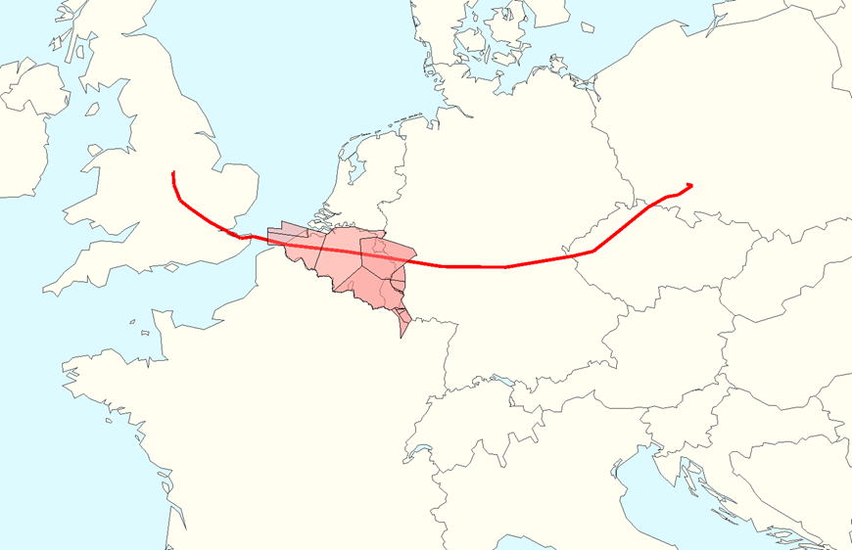
CASE Study: MUAC
Operational Efficiency depends on multiple factors ..such as Sector Capacity availability, Military Airspace usage, Route Charges, Fuel price, etc.
Means to mitigate negative effects of fragmentation:
Network throughput optimization
..rather than throughput on ATC sector or ACC level
Improved traffic predictions
..such as Traffic Prediction Improvement Project
Network centric planning and execution
..such as eNM measures
Optimized Flexible Use of Airspace
City pair east midlands-wroclaw

Slide 11
Conclusions
Discussions on Fragmentation is rather lead by perceptions than by facts
Measure Fragmentation remains unclear so far
Based on selected indicator, Level of Fragmentation in Europe has considerably decreased over the last 12 years
Impact of Fragmentation on Performance not clear
Case Studies give evidence that with Fragmentation, efficiency can be increased,
or by means of new technology or new processes the negative effects can be mitigated.

